Slide 1
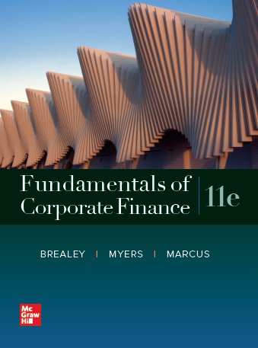
Fundamentals of Corporate Finance, 11th Edition
CHAPTER 5: The Time Value Of Money
© McGraw Hill LLC. All rights reserved. No reproduction or distribution without the prior written consent of McGraw Hill LLC.

Slide 2
Effective Interest Rates (1 of 3)
Effective Annual Interest Rate
Interest rate that is annualized using compound interest
Annual Percentage Rate
Interest rate that is annualized using simple interest
Notes:
26

Slide 3
Effective Interest Rates (1 of 3)
Effective Annual Interest Rate
“If the bank is charging me 12% per year, but I have to pay monthly, what rate I am effectively paying?”
“… what rate I am really paying?”
Notes:
26

Slide 4


Effective Interest Rates (2 of 3)
Annual Percentage Rate (APR)
$$\text{APR}\text{ = }\text{MR} \text{×} \text{12}$$
Effective Annual Interest Rate (EAR)
$$\text{EAR}\text{ = }\left(\text{1 + }\text{MR}\right)\text{12 }\text{− 1}$$
*where MR = monthly interest rate
Notes:
26
Effective annual interest rate: Interest rate that is annualized using compound interest.
Annual percentage rate: Interest rate that is annualized using simple interest.

Slide 5
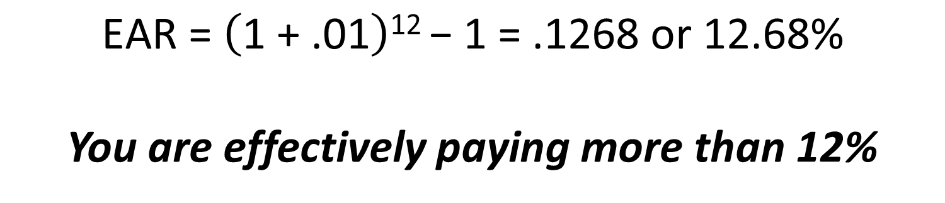
Effective Interest Rates (3 of 3)
Example
Given an annual rate of 12%, what is the Effective Annual Rate(EAR)? (Monthly rate equals 1%)
$$\text{EAR}\text{ = }\left(\text{1 + .01}\right)\text{12 }\text{− 1 = }\text{r}$$
$$\text{EAR}\text{ = }\left(\text{1 + .01}\right)\text{12 }\text{− 1 = .1268 }\text{or}\text{ 12.68\%}$$
You are effectively paying more than 12%
Notes:
28

Slide 6
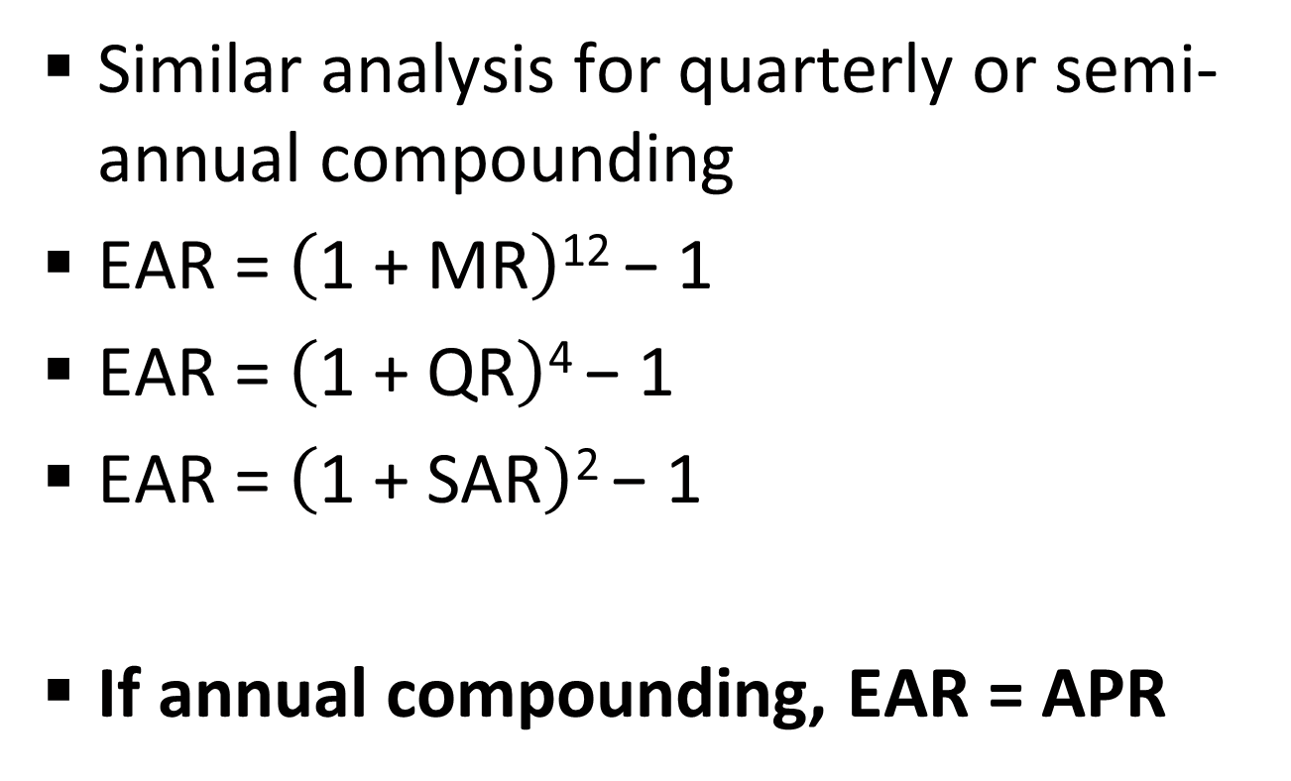
Effective Annual Rate
Similar analysis for quarterly or semi-annual compounding
$\text{EAR}\text{ = }\left(\text{1 + }\text{MR}\right)\text{12 }\text{− 1}$
$\text{EAR}\text{ = }\left(\text{1 + }\text{Q}\text{R}\right)\text{4} \text{− 1}$
$\text{EAR}\text{ = }\left(\text{1 + }\text{SA}\text{R}\right)\text{2 }\text{− 1}$
If annual compounding, EAR = APR

Slide 7
Inflation (1 of 5)
Inflation
Rate at which prices as a whole are increasing
Nominal Interest Rate
Rate at which money invested grows
Real Interest Rate
Rate at which the purchasing power of an investment increases
Notes:
57

Slide 8
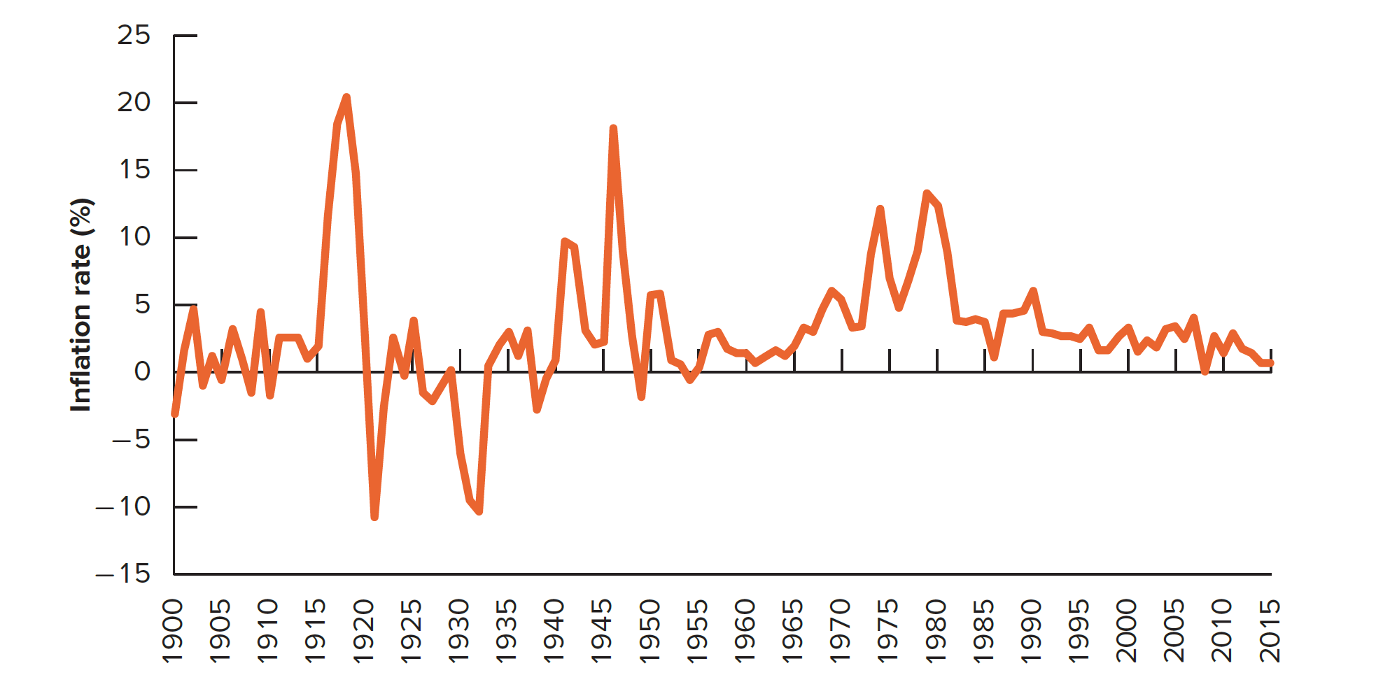
Inflation (2 of 5)
Annual U.S. Inflation Rates from 1900 - 2015

Slide 9
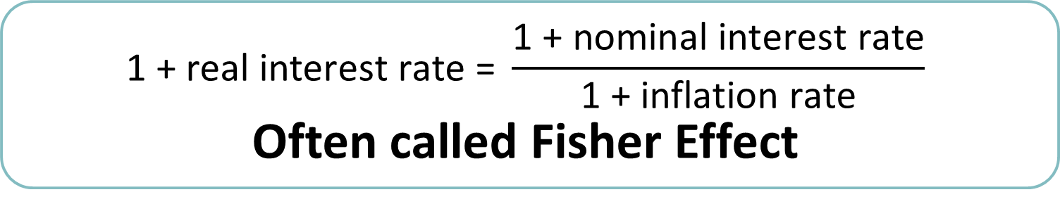
Inflation (3 of 5)
$$\text{1 + }\text{real} \text{interest} \text{rate}\text{ = }\frac{\text{1 + }\text{nominal} \text{interest} \text{rate}}{\text{1 + }\text{inflation} \text{rate}}$$
Often called Fisher Effect
Approximation formula
$$\text{Real} \text{int}\text{. }\text{rate}\text{ ≈ }\text{nominal} \text{int}\text{. }\text{rate}\text{ − }\text{inflation} \text{rate}$$
Notes:
59

Slide 10
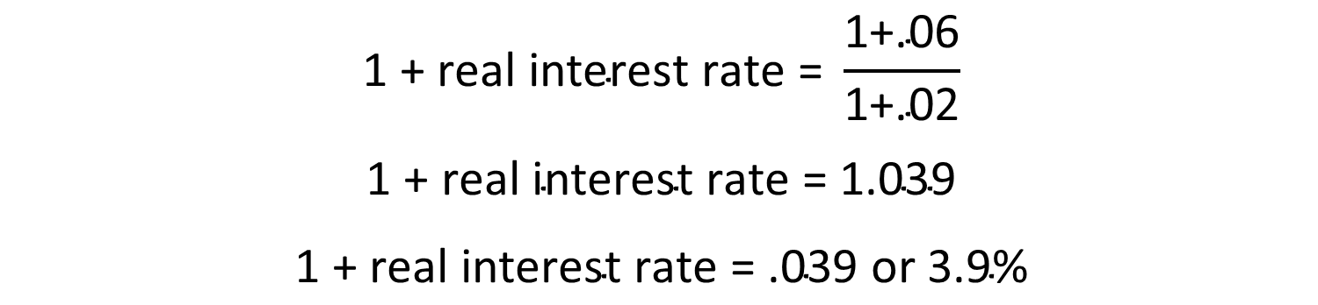
Inflation (4 of 5)
Example
If the interest rate on one year govt. bonds is 6.0% and the inflation rate is 2.0%, what is the real interest rate?
$$\text{1 + }\text{real} \text{interest} \text{rate}\text{ = }\frac{\text{1+.06}}{\text{1+.02}}$$
$$\text{1} \text{+} \text{real} \text{interest} \text{rate} \text{=} \text{1.039}$$
$$\text{1} \text{+} \text{real} \text{interest} \text{rate} \text{=} \text{.039 }\text{or}\text{ 3.9\%}$$
$$\text{Approximation}\text{ = .06 − .02 = .04 }\text{or}\text{ 4.0\%}$$
Notes:
62

Slide 11
Inflation (5 of 5)
Remember:
Current (nominal) dollar cash flows must be discounted by the nominal interest rate
Real cash flows must be discounted by the real interest rate
I-Core Case

Slide 12
Discount Example, real and nominal
You will receive a $10,000 bonus in one year, but the inflation rate is expected to be 6%; assume the discount rate is 10%
What is your bonus worth today? PV = FV/(1 + r)^{t}
Nominal: $10,000/(1.10)¹ = $9,090.91
Real: Step One: what is bonus purchasing power? $10,000/1.06
= $9,433.96
Step Two: what is Real discount rate? 1.10/1.06 – 1 = .037735849
Step Three: $9,433.96/(1.037735849)¹ = $9,090.91
Nominal CF with Nominal rate; Real CF with Real rate

Slide 13
What is next?
Chapter 6: Valuing Bonds
Go back to Lecture 2
You need a 6.5% annual return to justify the risks of the following financial contract: you will receive annual payments of $50 for five years and one lump sum payment of $1,000 in five years. What price should you pay for the contract?
That’s a bond—we calculated the price to be $937.66
“i” vs. “r”

